Slide 1
GAMES PLAYING USING REINFORCEMENT LEARNING
Under the Guidance of,
Mr.P.DURGA PRASAD
Submitted By,
CH.VAMSHI(4511-18-733-017)

Slide 2
CONTENTS
1. ABSTRACT
2. INTRODUCTION
3. EXISTING SYSTEM & DISADVANATGES
4. PROPOSED SYSTEM & ADVANTAGES
5. ARCHITECTURE / BLOCK DIAGRAM
6. SYSTEM REQUIREMENT SPECIFICATION
7.MODULES & THEIR DISCRIPTION
8.UML DIAGRAMS
9. OUTPUT SCREENS
10. CONCLUSION
11. FUTURE ENHANCEMENT
12. REFERENCES & BIBLOGRAPHY

Slide 3
ABSTRACT
Reinforcement learning is a self-learning algorithm in which an agent acquires experience through continuous interaction with the environment, which is more like the process of human.
This method allows an agent to estimate the expected utility of its state in order to make optimal actions in an unknown environment
We use Q-Learning to train agents to play trivial games like Flappy Bird, and we dive into Deep Reinforcement Learning to train the agents to play more complicated games.

Slide 4
INTRODUCTION
Games are not only entertainment, though. Training a virtual agent to outperform human players can teach us how to optimize different processes in a variety of different and exciting fields.
we will develop an AI agent that is able to learn how to play the popular game Snake from scratch.
To do it, we implement a Deep reinforcement Learning Algorithm using both Keras on top of Tensorflow and PyTorch.

Slide 5
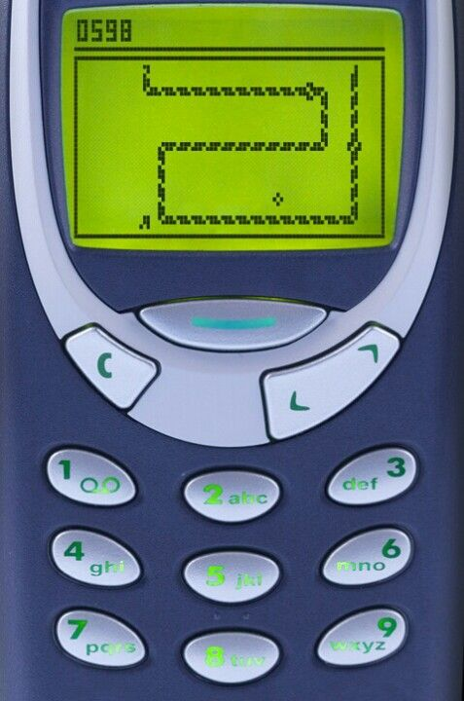
EXISTING SYSTEM
Gaming is a very popular leisure activity. We have some benefits such as improving focus, multitasking, and working memory.
that expert players of real-time strategy games have faster information processing.
Human Neuroscience suggest that playing such games can cause long-term changes in the brain and lead to an improvement in temporal visual selective attention.

Slide 6
DISADVANTAGES
Repetitive stress injuries and other health risks.
Poor mental health.
Relationship issues.
Social disconnection.
Exposure to toxic gaming environments.
Human could not reach End step of games in less time.

Slide 7
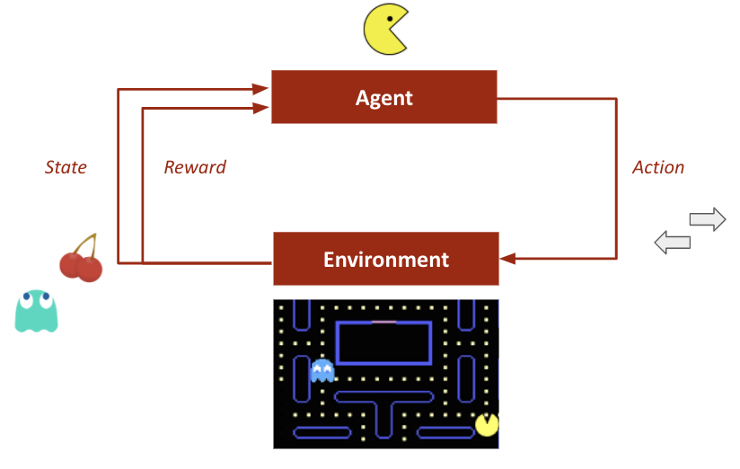
PROPOSED SYSTEM
REINFORCEMENT LEARNING:
reinforcement learning agent is able to perceive and interpret its environment, take actions and learn through trial and error.

Slide 8
ADVANTAGES
Using reinforcement learning, we can improve and personalize the gaming experience in real-time.
It is the algorithm that can solve different games and sometimes achieve super-human performance.
This technology is used for the learning of robots.

Slide 9
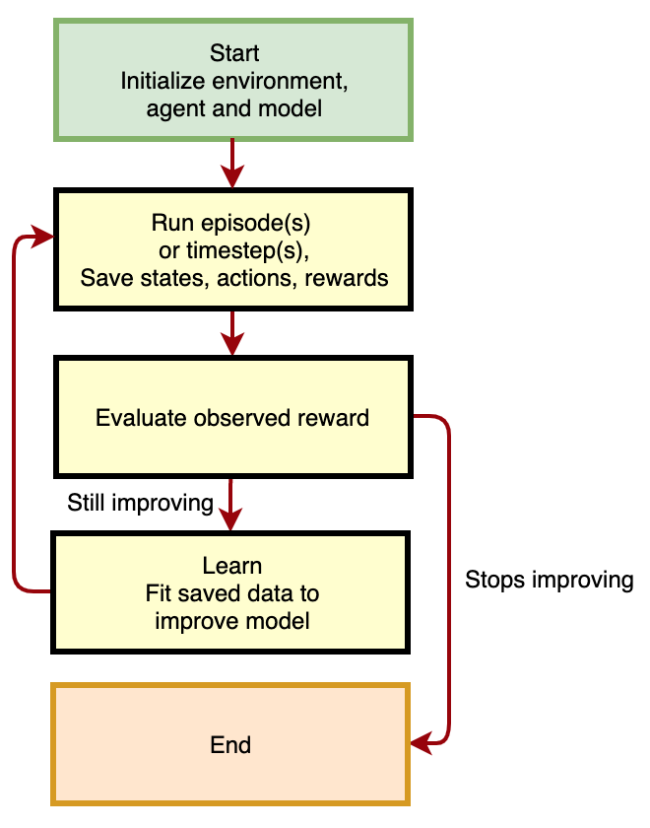
BLOCK DIAGRAM

Slide 10
SYSTEM REQUIRMENTS
Operating system:windows10 pro
Coding language: Python(3.0)
Domain: Machine learning
HARDWARE REQUIREMENTS
PROCESSOR:2.70GHz
RAM :4 GB
HARD DISK:320 GB

Slide 11
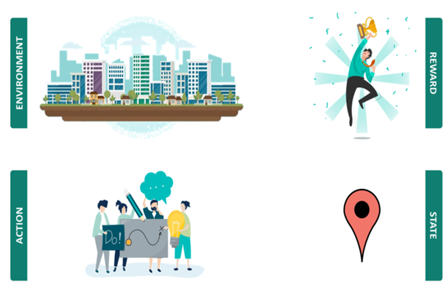
MODULES & DESCRIPTION
Deep Q Learning.
State.
Loss.
Reward.
Model Implementation.
Results

Slide 12
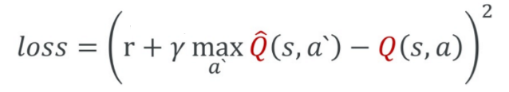
Deep Q Learning:
Deep Q-Learning replaces the regular Q-table with a neural network. Rather than mapping a state-action pair to a q-value, a neural network maps input states to (action, Q-value) pairs.
Environment:
the Agent's world in which it lives and interacts.
State:
A state is the representation of a situation in which the agent finds itself. The state also represents the input of the Neural network..
Loss:
difference between the real target and the predicted one.
Reward:
a positive reward is only given to the agent when it eats the food target (+10). If the snake hits a wall or hits itself, the reward is negative (-10).

Slide 13
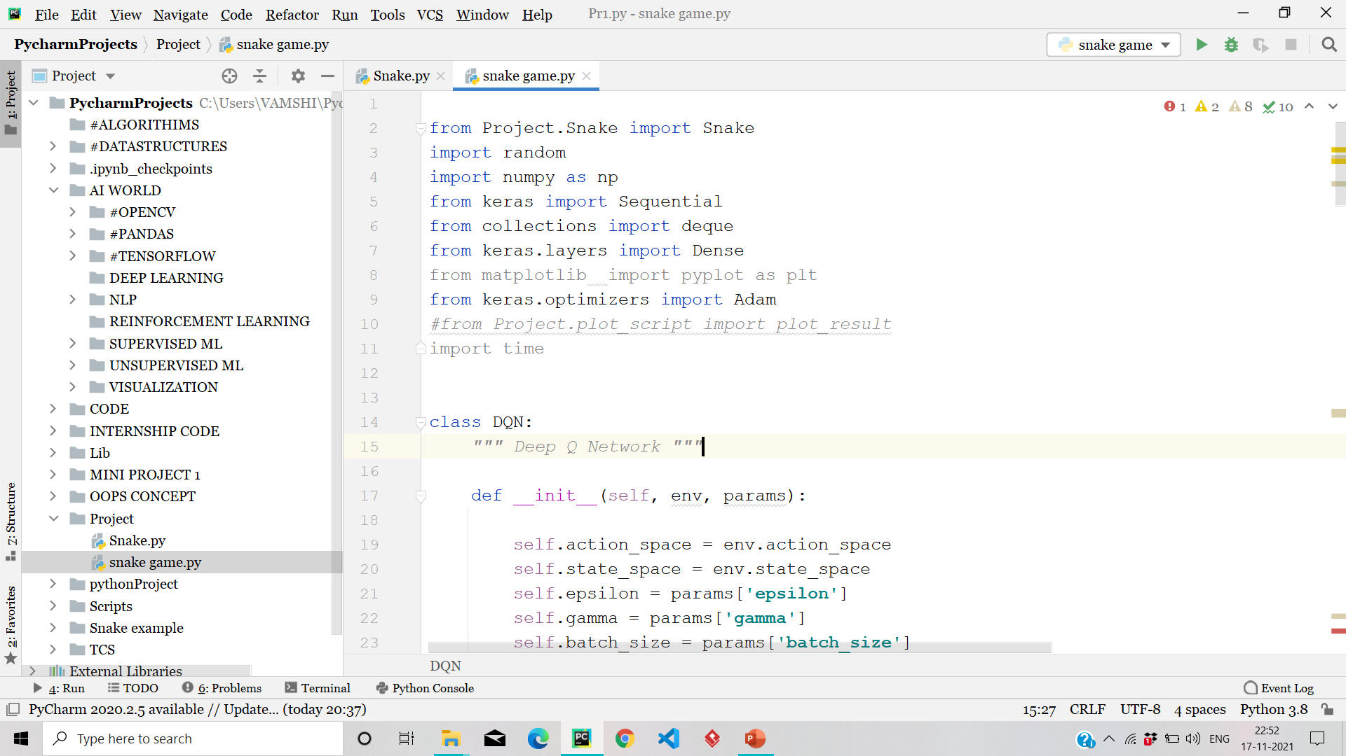
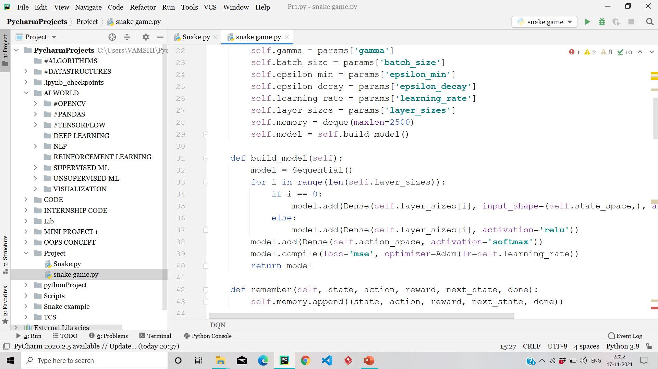

Slide 14
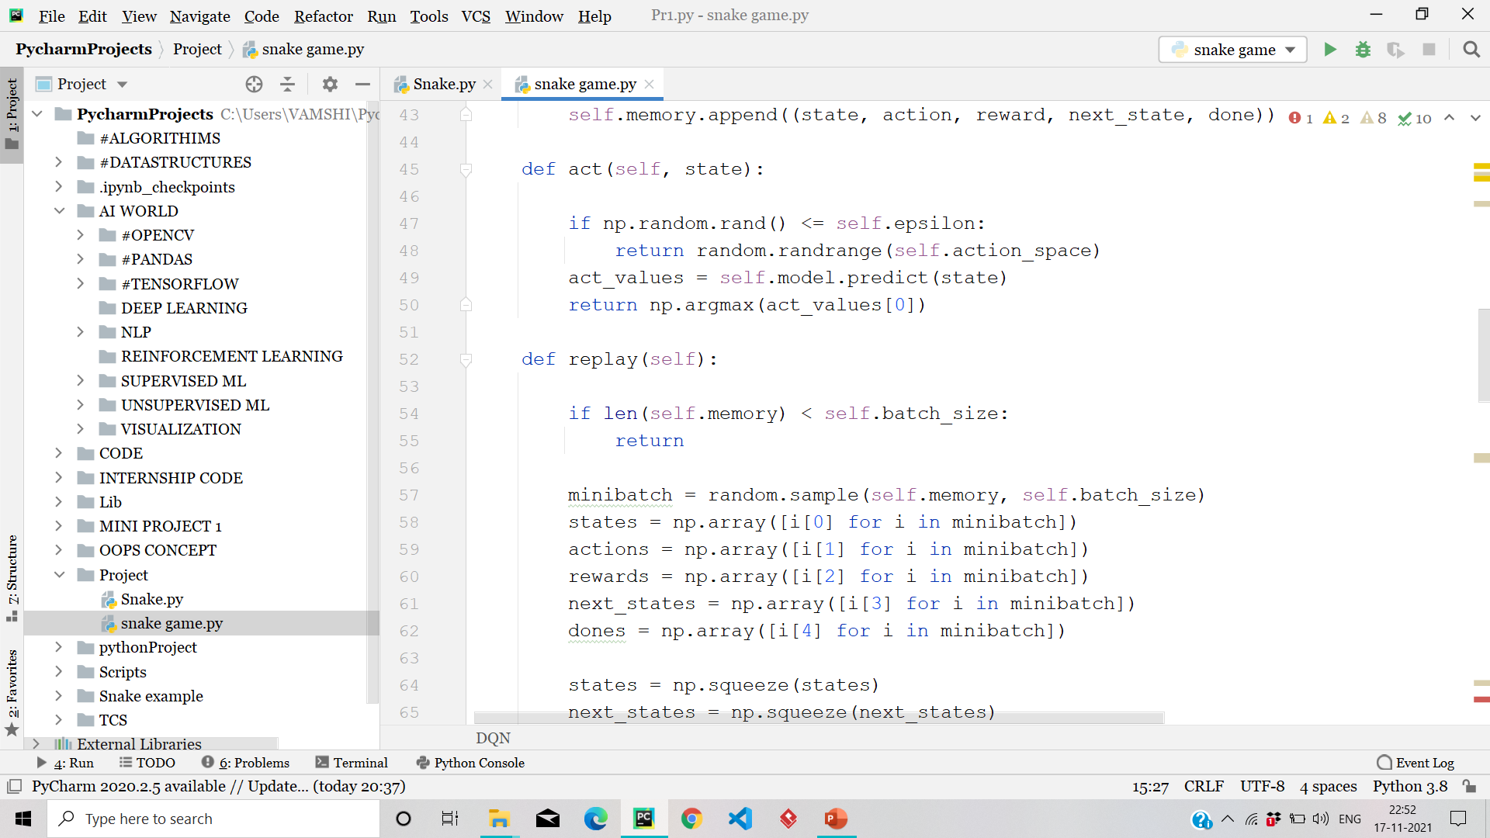
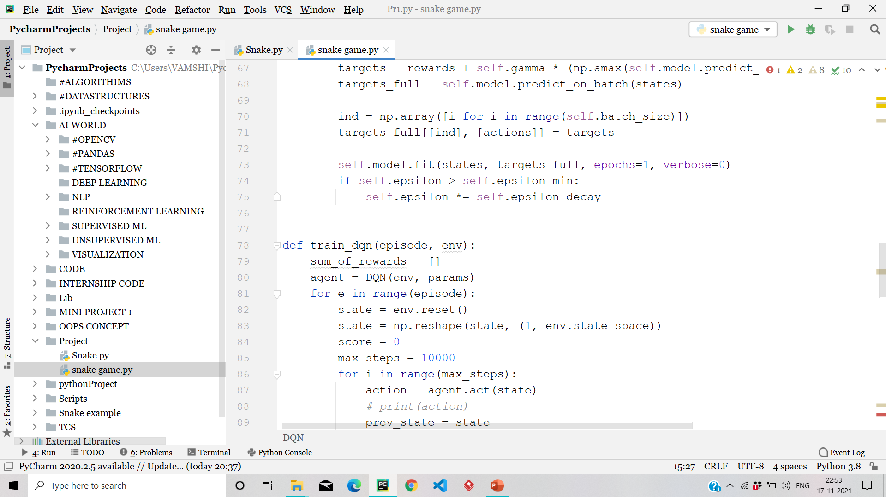

Slide 15
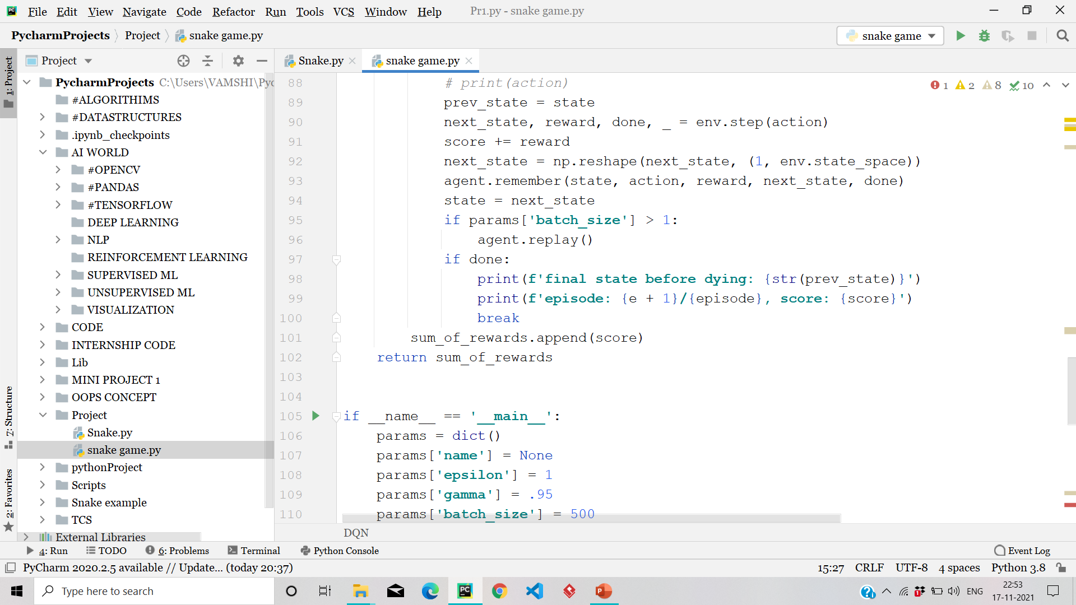
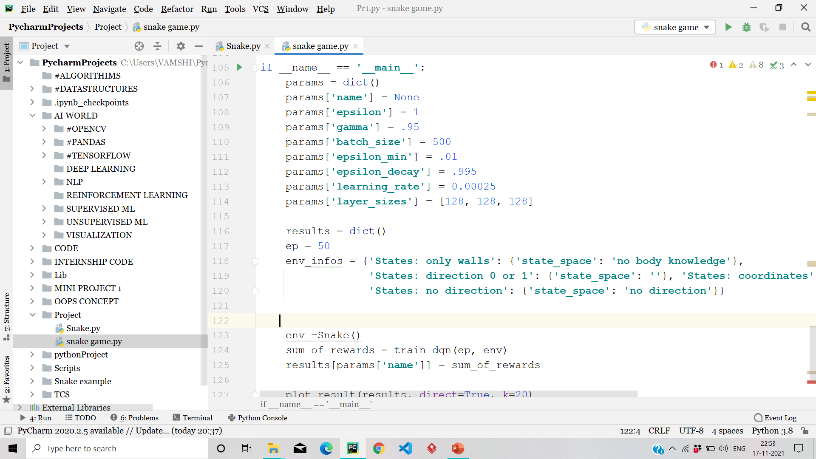

Slide 16
OUTPUT SCREEN

Slide 17
CONCLUSION
This example shows how a simple agent can learn the mechanism of a process, in this case the game Snake.
As we can see in the plot below, during the first 50 games the AI scores poorly: less than 10 points on average. This is expected: in this phase, the agent is often taking random actions to explore the board and store in its memory many different states, actions, and rewards.
During the last 50 games, the agent is not taking random actions anymore, but it only chooses what to do based on its neural network (its policy).

Slide 18
THANK YOU

